Slide 1


Slide 2
CHALLENGES & DELIVERABLES
Marketing Strategy
Advertising
Gaining new customers
Branding
Content Strategy
Website Analysis/Recommendation

Slide 3
HOW-TO GUIDES (IN PROGRESS)
INSTAGRAM
FACEBOOK
SAMPLE POST SCHEDULES
CRM (best practices & recommendations)

Slide 4
Vision: Our vision is to reduce our collective global footprint by creating a space for sustainable fashion.
Mission: We strive to provide our customers with brand named pre-loved clothing through quality and convenient service.
Slogan: Save Money. Save the planet. Shop Green.

Slide 5
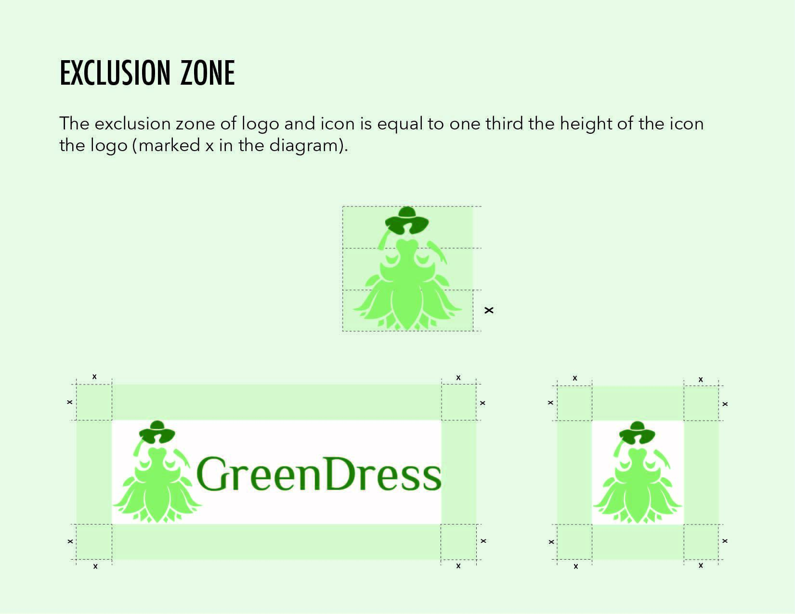
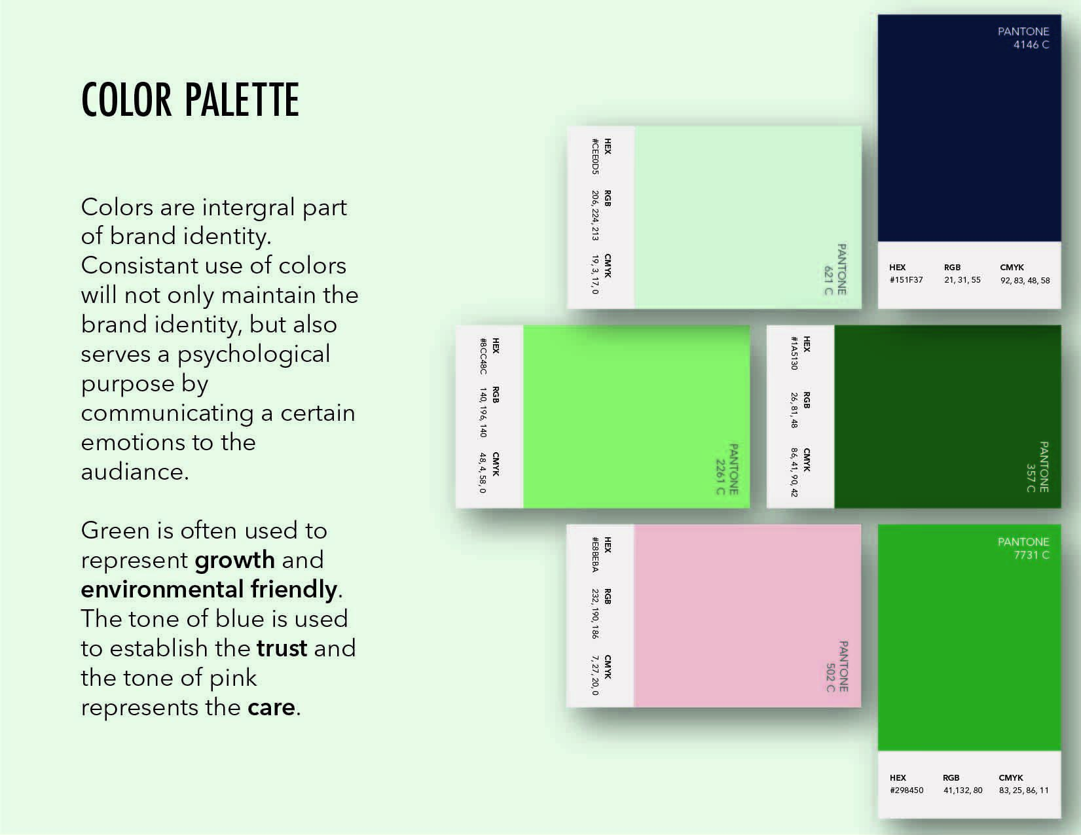
BRAND STYLE GUIDE

Slide 6
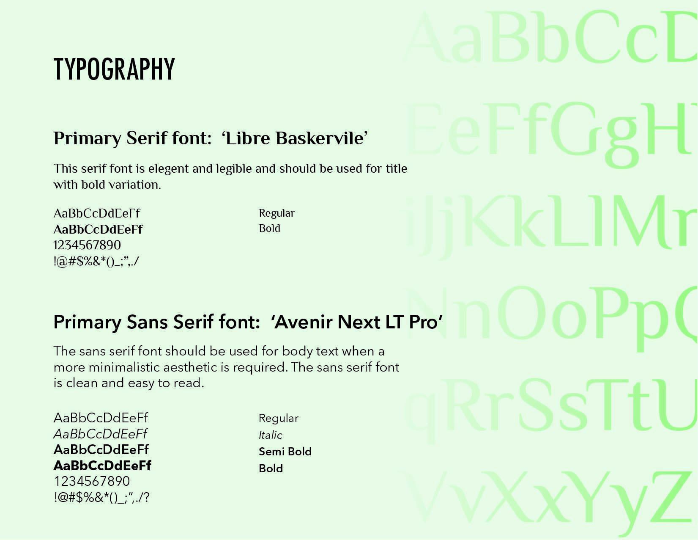
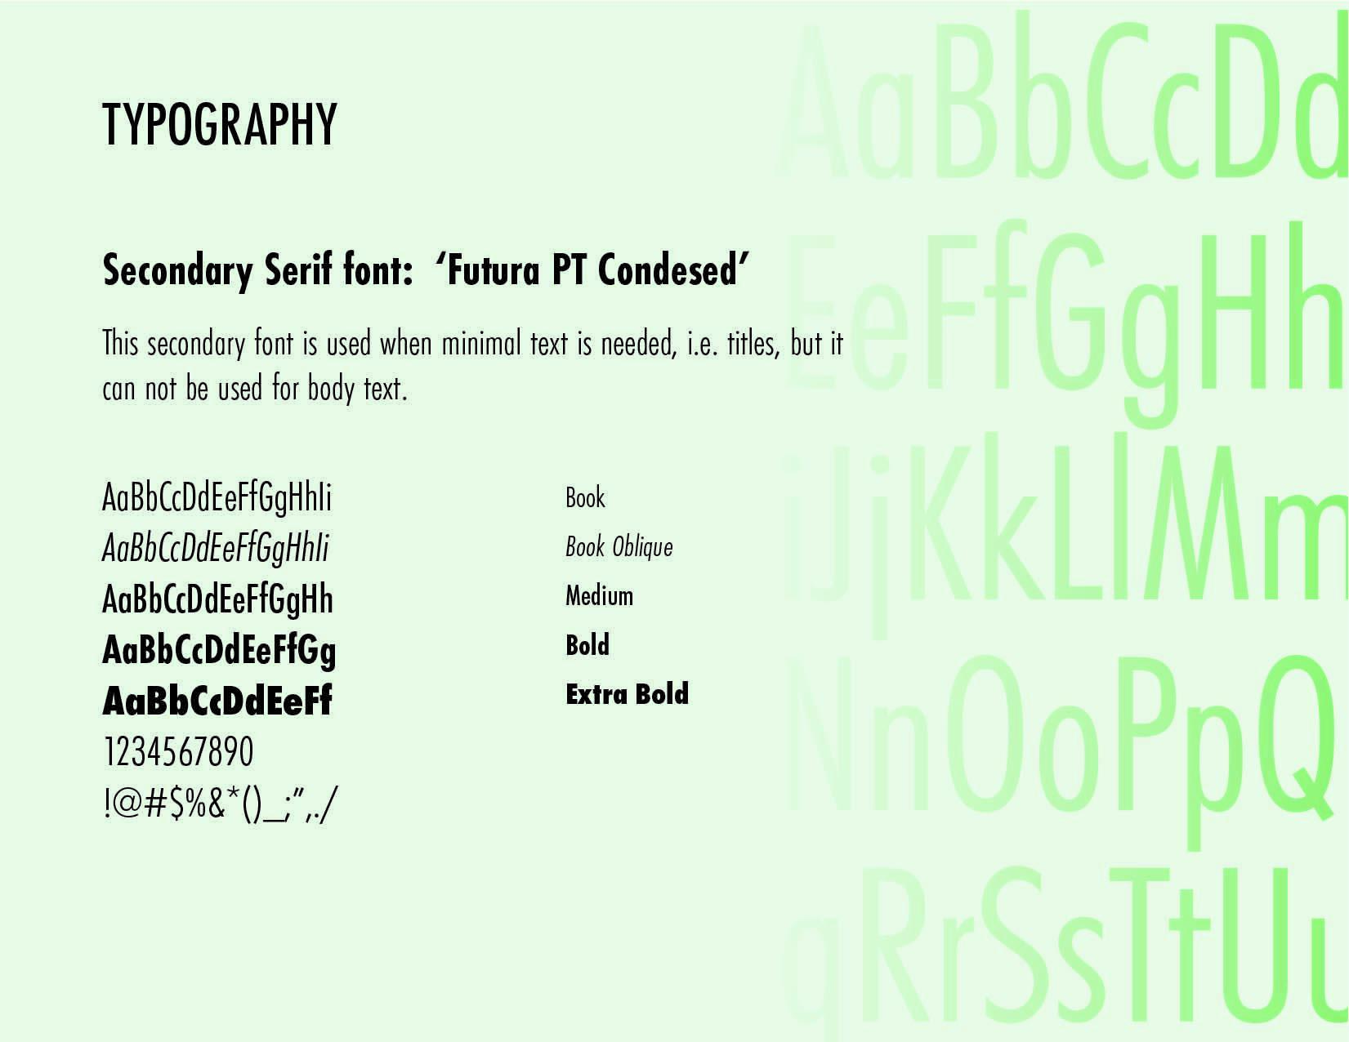
BRAND STYLE GUIDE

Slide 7
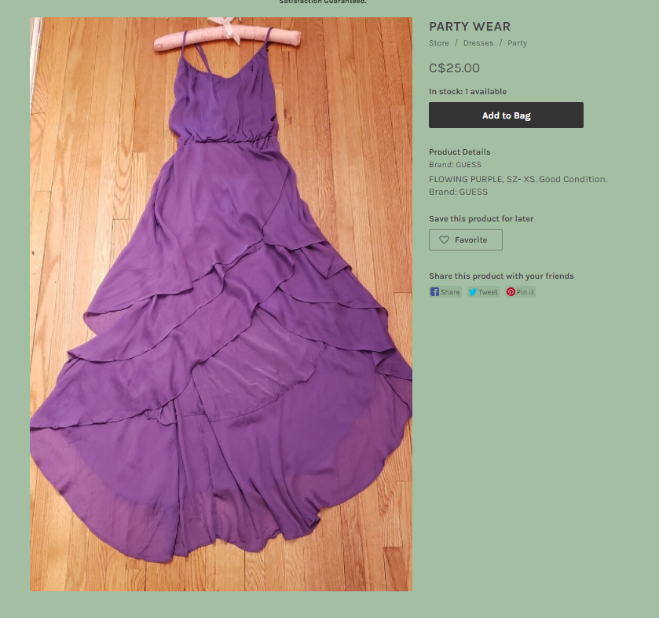
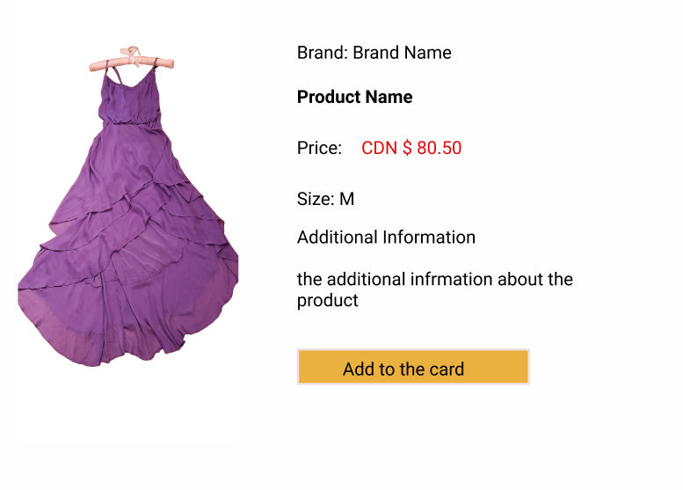
Website Analysis/Recommendation
Too many styling colors/animations (UI/UX)
By limiting the use of color, the areas that do receive color gain more attention.

Slide 8
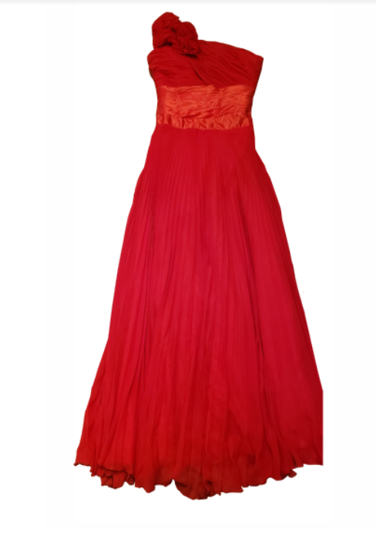
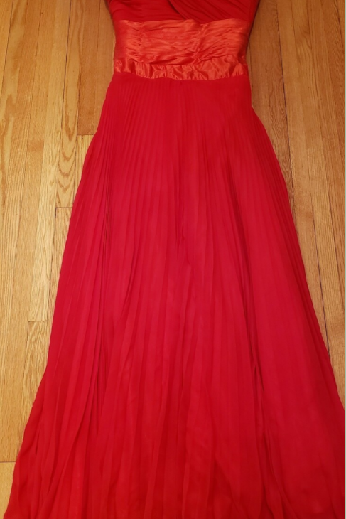
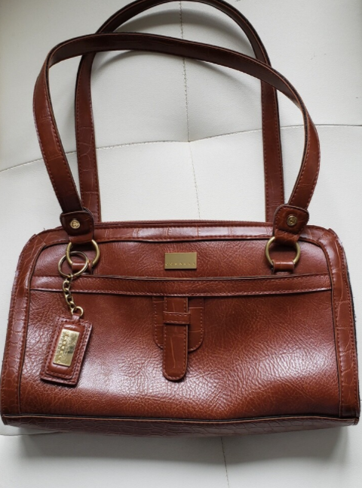
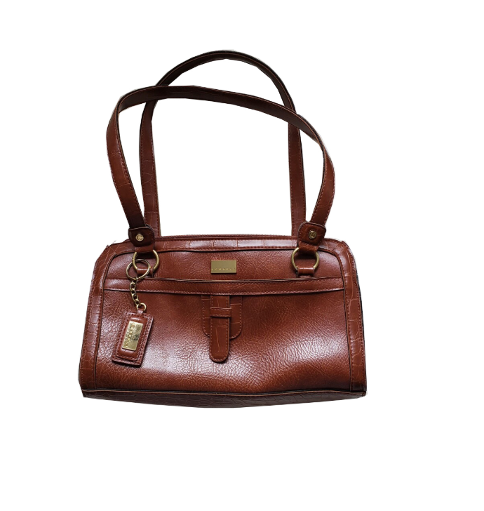
Website Analysis/Recommendation
Increase the quality of pictures
High quality of product image increases sales

Slide 9
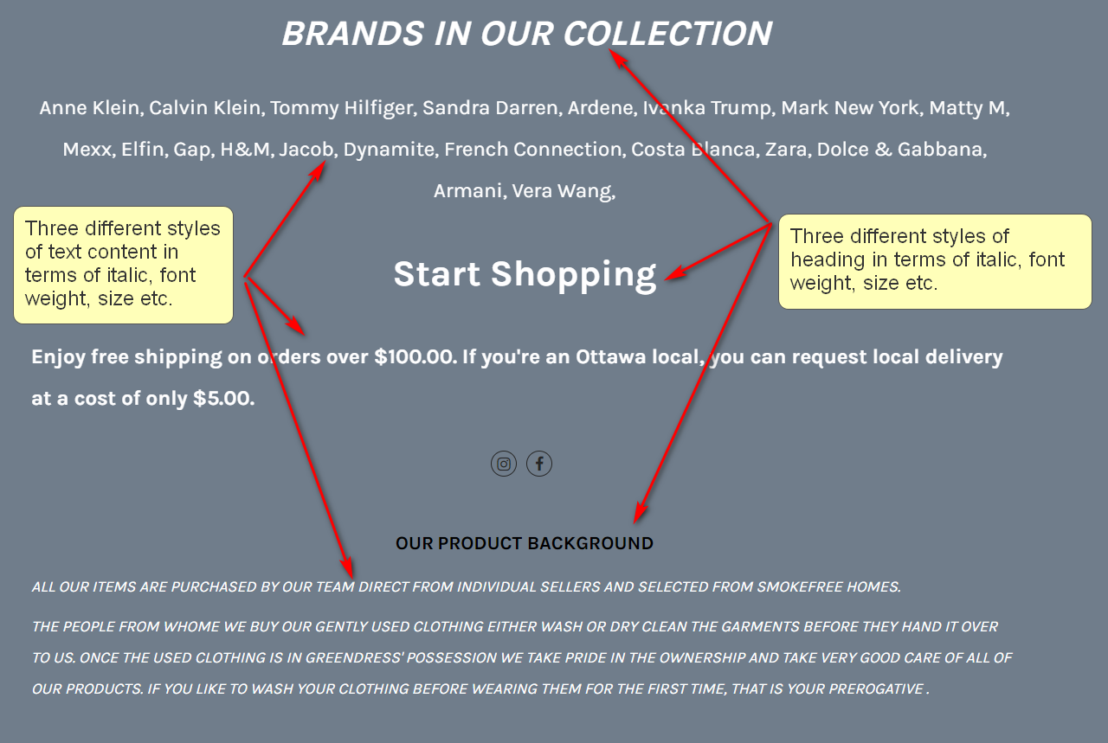
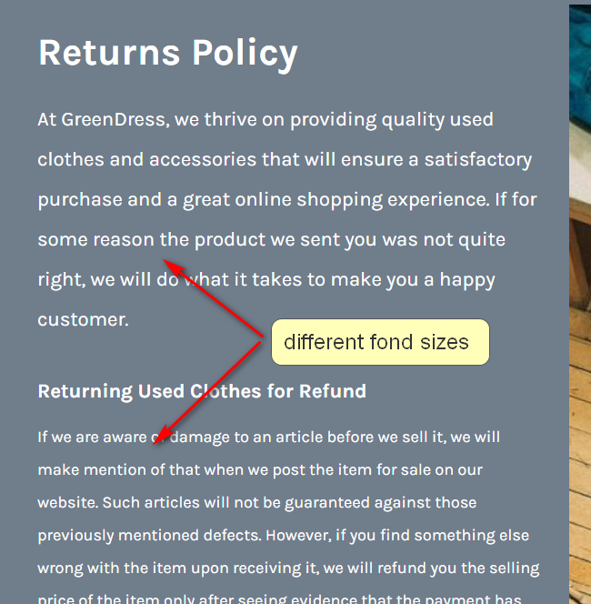
Website Analysis/Recommendation
Inconsistent font families, styles and sizes
Use the same font family, style and size for Heading and text paragraph to increase the credibility of the website.

Slide 10
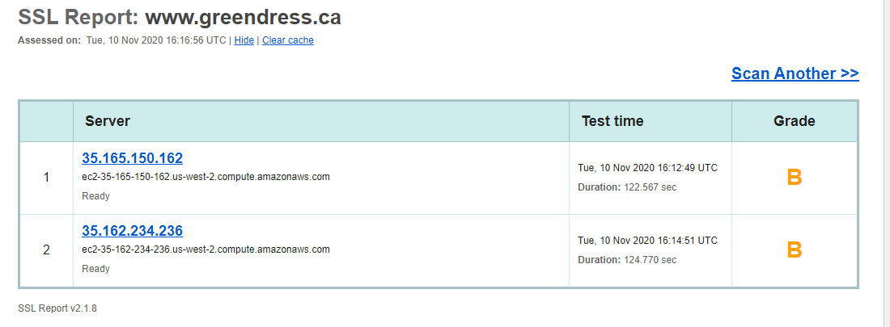
Website Analysis/Recommendation
Increase the security level
The security level of the current website is B (test from SSL LABS)

Slide 11
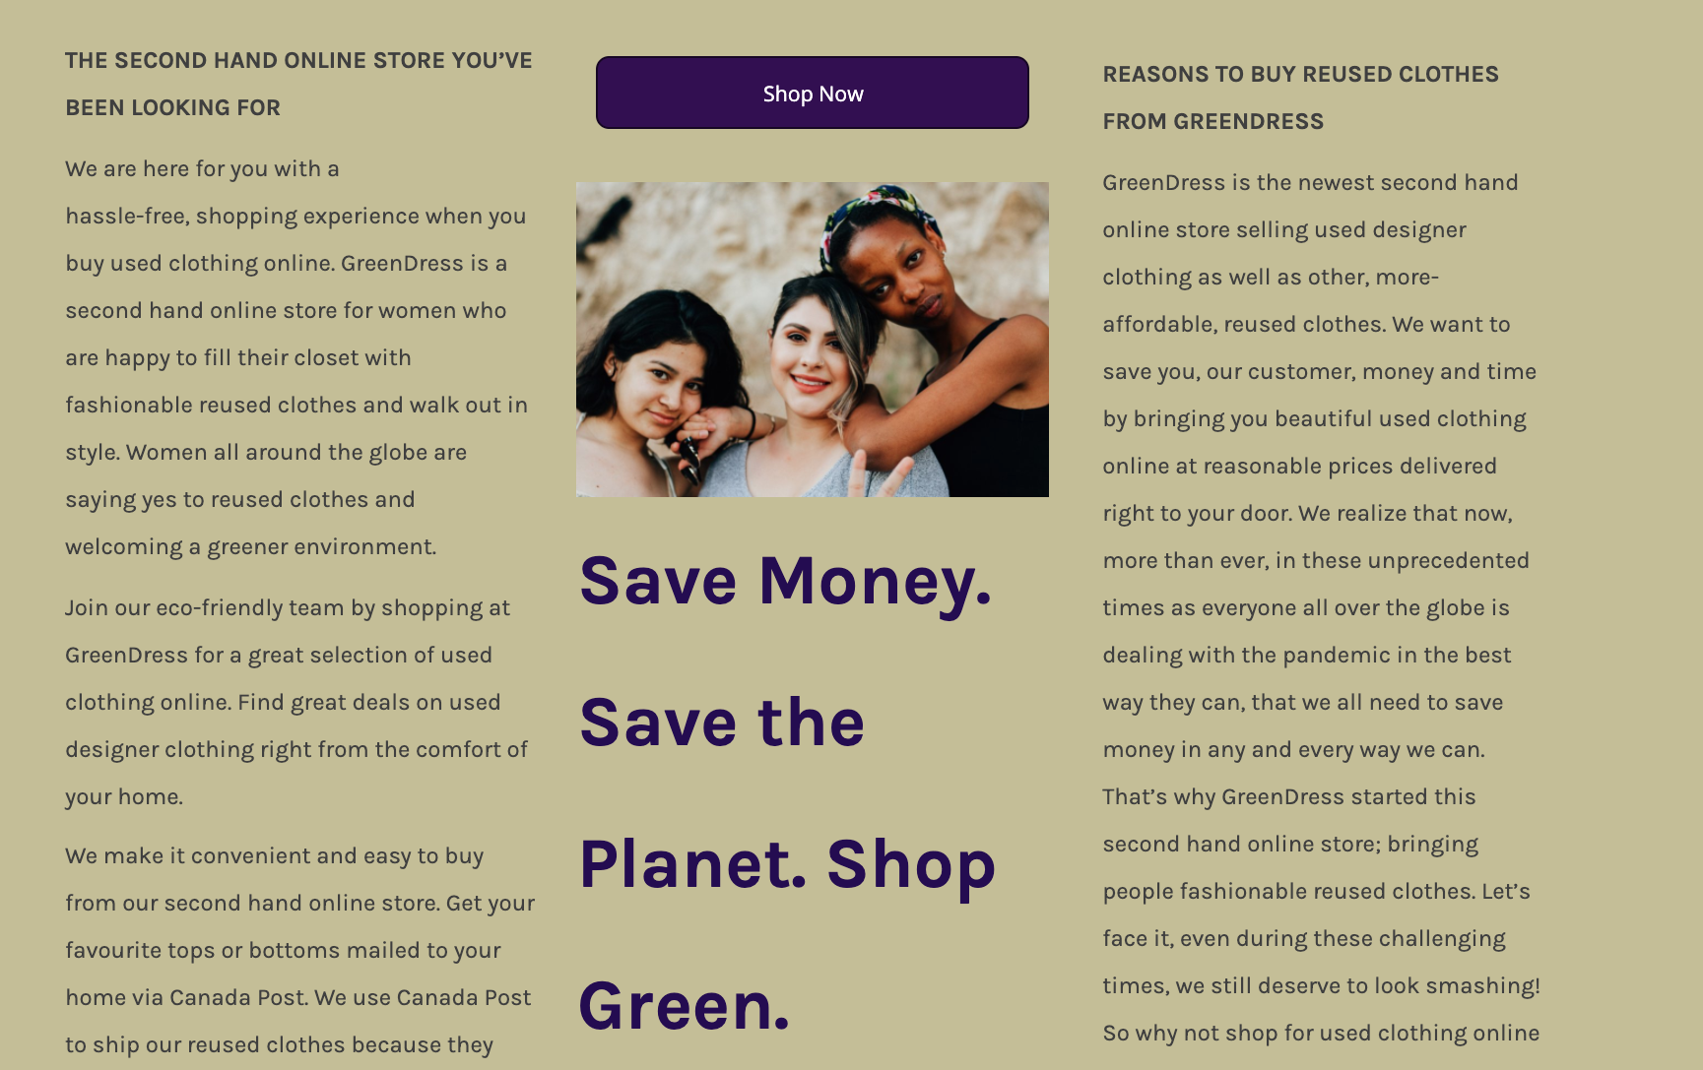
Revise
Website
Copy

Slide 12
CRM recommendations
Outline CRM basics and why GreenDress should invest into one
The pros and cons of CRM
How to attract and retain potential and long-term consumers
How to leverage data to keep up with profitable endeavours and leverage data for areas of opportunity

